Slide 1
PYTHON
Session 1- Getting Started

Slide 2
What Is Python?
Notes:
It is the language we will be learning over this course. Just in day to day we have different language variants, you might speak English, you might speak French. The same is true for computer programming.
The same concepts and ideas you will learn here you will be able to use in other languages.
The reason we start with python- it’s a nice simple language to read, it is quite understandable in sort of plain English.

Slide 3
What Is Programming?
Notes:
So programming is how we talk to computers , it allows us to tell them what we want them to do, in a logical manner. You can computers to different things in different ways. Process images etc.

Slide 4
What Is It Used For?
Notes:
Python is used across the world in massive business and also tiny businesses, used in personal and professional projects for a wide variety of reason. It is used to process data. What it means is that tranfer and transform data from one state to another. Might have a giant list of peoples names and address and reformat that to send an email or filter the data and python allows us to quickly and easily do that. It is also used extensively for websites and as part of webapps. Lots of apps on mobile phones and laptops will be powered in python. |Examples such as uber website uses it in the backend extensively. Tiktok, facebook, Instagram etc.

Slide 5
Who Uses It?
Notes:
Uber, facebook, insta are some of the examples you might know

Slide 6
Hello, World!
Notes:
So the tradional first example we always use for any programming is hello world it is basically just getting the computer to print the message back to you.

Slide 7
Hello, World!
print (“Hello, World!”)
Notes:
So the tradional first example we always use for any programming is hello world it is basically just getting the computer to print the message back to you.
Here you are calling a statement called print and passing a statement called hello world, when you code this and run It the computer will run this. This may sound basic but it is the basis of coding. When you are doing complex calculations you might need to check something and the print statement will allow you to do so
Lets go through some more basics

Slide 8
Text Editor
Notes:
We will put all of our code in a text editor. For this course we are using an online service which is completely free.

Slide 9
REPL.IT
Notes:
If you enter this in your browser you can sign up to it. You can make different repls and have different lessons stored in it .

Slide 10
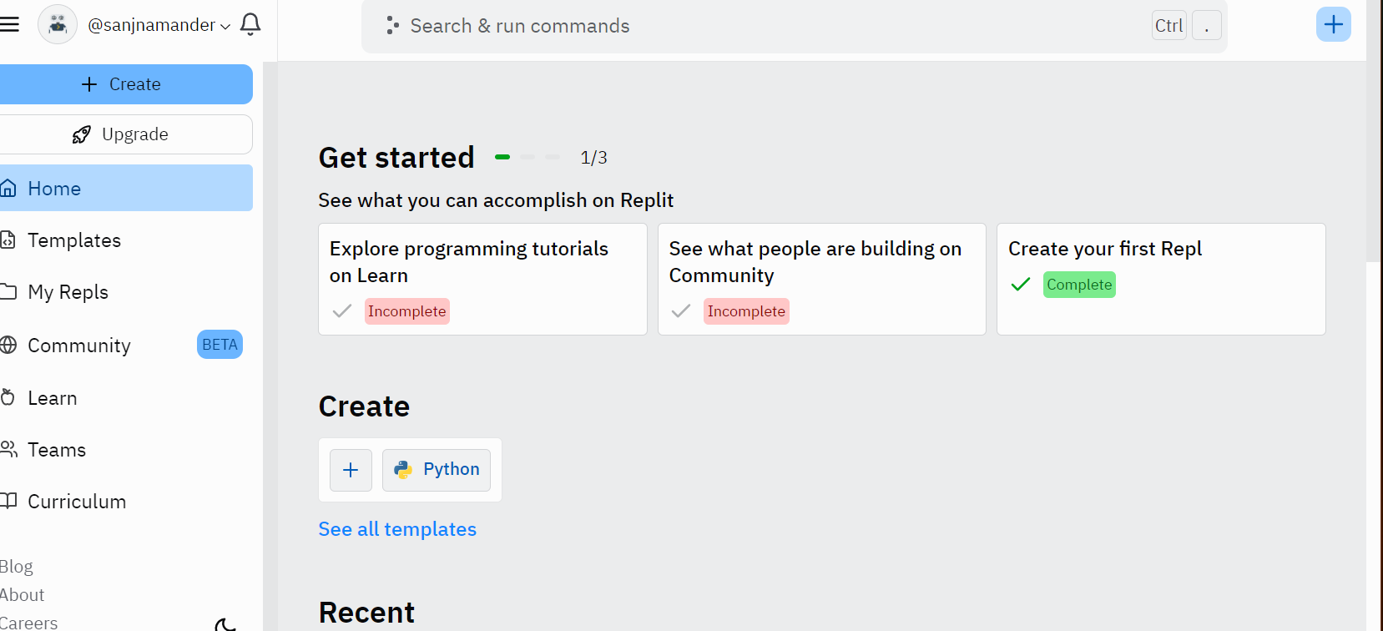
Notes:
You have a file called main.py, this is where all the code will go to and you might need to create more files as the lessons go on. I will give you all some time to navigate that, once this is done ill give a demo.
Everything you write will run in order, so when you hit the run button it will run line by line

Slide 11
Naming Python Files
what_the script_does.py
calculate_totals.py
send_emails.py
Notes:
The files always need the .py extension for them to run in python. It is short for pyhton
For the duration of the course everything will be mostly in main.py. Other imp thing is to avoid using spaces as they make it harder to manage. So using underscores is useful making it easier to run.

Slide 12
Naming Python Files
Lowercase
Underscore instead of spaces
No punctuation
Notes:
These are tips for eliminating any extra errors

Slide 13
Hello, World!
print (“Hello, World!”)
Notes:
Now lets get to coding
The text you want to echo out will be between the quotes

Slide 14
Variables
Notes:
Variables in programming allow us to store information, same as algebra x= some value etc

Slide 15
Variables
<variable_name> = <value>

Slide 16
Variables
name = “Sanj”
age = 28
left_to_pay = 28.7
has_paid = False
Notes:
Here are some examples of variables. This is stored value of name in name within a string. Integers can be stored without string but all of this we will cover in later sessions. No spaces in variable names. There is a single equal sign, it is the assignment operator. Basically telling it ot store.

Slide 17
Variables
Any mix of letters, numbers and some special characters
Must start with a letter
Keep lowercase
Use underscore where there are spaces
Notes:
These are tips for eliminating any extra errors

Slide 18
Data Types
Notes:
Variables in programming allow us to store information, same as algebra x= some value etc

Slide 19
Strings
Notes:
In the previous slides we covered a few data types the first one you saw was strings
That was in the variable called name for Charlie. Anything surrounded by quotes is a string

Slide 20
Strings
Characters surrounded by quotes
name = “Sanj”
address = “Victoria Residence”
Notes:
Here are some examples of variables. This is stored value of name in name within a string. Integers can be stored without string but all of this we will cover in later sessions. No spaces in variable names. There is a single equal sign, it is the assignment operator. Basically telling it ot store. Thinking about real life examples you will need a diff container for rice vs that for water and the data types are like containers for various different types of items. So same idea in programming. All strings are always surrounded by quotes can be double or single as long as they are the same at the beginning and at the end.

Slide 21
Escaping
Notes:
It allows us to add additional character and meaning in coding

Slide 22
Escaping
\n = New line
\t = Tab
\” = Double Quote
Notes:
\n is interpreted as new line, \t indents your content
\” a double quotes wijtin a quote

Slide 23
Escaping
favourite_food = “Pizza from \”Dough N’ Sauce\””
shopping_list = “Apples\nBread\nMilk\nEggs\”
Notes:
If we don’t escape the quote python will think we are done with the assignment

Slide 24
Coding Time
Section A
Notes:
It allows us to add additional character and meaning in coding

Slide 25
Section A
Write code that prints ‘Hello world’.
Print the numbers 1 to 5 on a single line.
Write a script where ‘Hello’ and ‘World’ are printed on two separate lines.
Write a script that prints a list of names, tabbed on separate lines, e.g.
My List of Names:
Alice
Bob
Charlie

Slide 26
Integer
Notes:
It allows us to add additional character and meaning in coding

Slide 27
Integer
A whole number
age = 28
days_in_january = 31
number_of_bottles = 99
Notes:
Integer is a whole number, the main thing you need to take from this differs from next data type

Slide 28
Float
Notes:
It allows us to add additional character and meaning in coding

Slide 29
Integer
A decimal number
price = 28.55
percentage = 31.7
Notes:
As you can see float differs from the previous data type integer in the meaning that it is a decimal number

Slide 30
Boolean
Notes:
It allows us to add additional character and meaning in coding

Slide 31
Boolean
True or False
has_paid = True
is_here = False
Notes:
Another data type is Boolean. This is basically a true or false statement, The words true and false have capital letters, this whrre capital matters if it is lowercase you will get an error.

Slide 32
None
Notes:
The final data type today is None

Slide 33
None
Absence of a value
last_film_seen = None
items_in_basket = None
Notes:
It is a zero or an empty string otherwise but if you want to represent absolutely no value None. And also notice the capital letter for None

Slide 34
Numerical
Operators
Notes:
The final data type today is None

Slide 35
Numerical Operators
Operator | Action | Example
+ | Addition | 1 + 1
- | Subtraction | 3 - 1
* | Multiplication | 2 * 4
/ | Division | 4 / 2
** | Exponent | 4 ** 2
% | Modulus(remainder) | 10 % 3

Slide 36
Numerical Operators
print ( 1 + 2 )
print ( 3 - 2 )
print ( 5 * 2 )
print ( 49 / 7 )
print ( 10 % 3 )
Notes:
It is a zero or an empty string otherwise but if you want to represent absolutely no value None. And also notice the capital letter for None

Slide 37
Numerical Operators
x = 3
y = 6
area = x * y
Notes:
Assign values and then use assignment to get to an end result

Slide 38
Concatenation
Notes:
The final data type today is None

Slide 39
Concatenation
first_name = “Sanj”
last_name = “Mander”
full_name = first_name + “” + last_name
print ( “Hello ” + first_name )
print ( “Good morning, ” + full_name )
Notes:
Fancy name for adding strings together, adding same data types together
Python is literal so if you need spaces you will need to add spaces

Slide 40
Order of Operations
Highest | () | Brackets
 | ** | Exponent
 | * | Multiplication
 | / | Division
 | + | Addition
Lowest | - | Subtraction

Slide 41
Order of Operations
sum = 4 + 5 * 2
correct_sum = (4 + 5) * 2
Notes:
Fancy name for adding strings together, adding same data types together
Python is literal so if you need spaces you will need to add spaces

Slide 42
Coding Time
Section B
Notes:
It allows us to add additional character and meaning in coding

Slide 43
Section B
Write code that prints the value of 2 + 2.
Write code that prints the value of 5.7 subtracted from 3.4.
Write code that prints the value of 8 multiplied by 7.
Write code that prints the value of 144 divided by 12.
Write code that prints the value of the remainder of 67 divided by 12.
Write code that finds the value of 20 from 4 - 2 * 6 / 3 * 5. Hint: you might need brackets.

